Slide 1
EXPLORATORY PROJECT
SEMESTER-IV 2021-2022

Slide 2
VOLUME CONTROL USING HAND GESTURE AND FINGER COUNTER IN HAND
Mentored by:
Prof. Dr Satyabrata Jit

Slide 3
AIM AND OBJECTIVES:
This project aims to create an interaction between machine hardware and hand gestures using landmarks on hand to minimize the use of hardware.
In the ongoing pandemic era, where prevention of contact is prioritized, this project accomplishes contactless technology services, which is the need of the hour.
Hence, our objective is to create a application through which we can illustrate the use of our project.
This project includes:
Volume control using hand movement
Counter using hand landmarks of fingers

Slide 4
LIBRARIES USED IN CREATING HAND MODULE:
OpenCV
OpenCV is the huge open-source library for computer vision. By using it, one can process images and videos to identify objects, faces, or even handwriting of a human.
Applications of OpenCV
Face recognition
Automated inspection and surveillance
Number of people – count (foot traffic in a mall, etc)

Slide 5
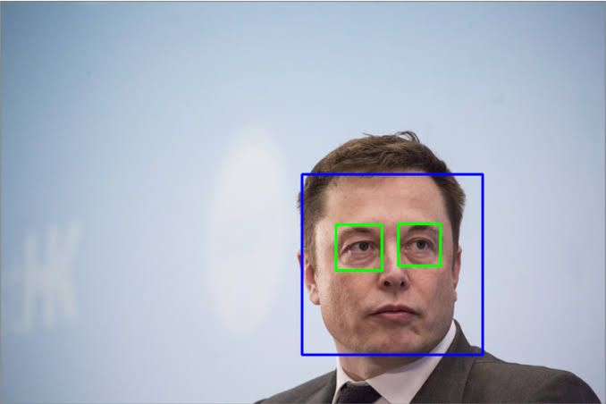
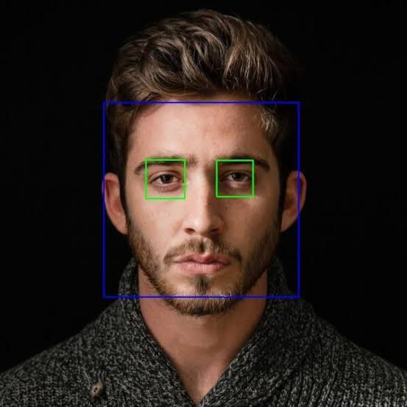
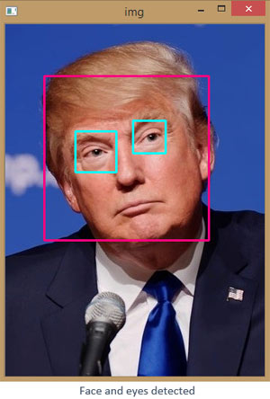
OpenCV used to detect eyes and face of a person

Slide 6
LIBRARIES USED IN CREATING HAND MODULE:
MediaPipe
MediaPipe Hands is a high-fidelity hand and finger tracking solution. It employs machine learning (ML) to infer 21 3D landmarks of a hand from just a single frame
Applications of MediaPipe
Human pose detection and tracking
Hand tracking
Face Detection

Slide 7
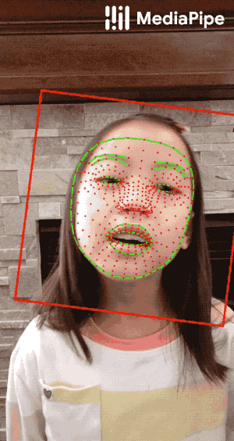
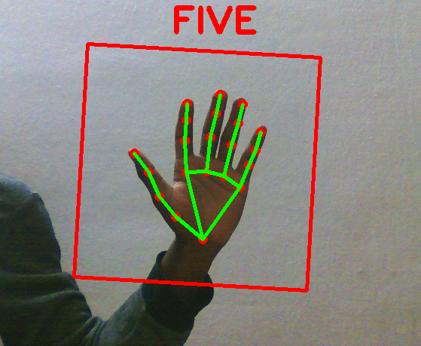
Face mesh
(468 landmarks)
Hand tracking (21landmarks)

Slide 8
Workflow to make hand module
Detecting land marks on hand (21)
Storing the position of landmark
Creating a hand module which will give positions of landmarks in live camera feed.

Slide 9
Now we can use this hand module to make volume controller and counter
Volume control using hand gesture
Counter using hand landmarks of fingers
Hand Tracking Module

Slide 10
HAND MODULE:
The work of hand module is divided into two parts as:
Palm detection model:
It basically detect hand from feed and detects 21 points on palm as shown in the figure 1.
Hand tracking model:
It finds co-ordinates of those 21 points on the detected palm with their corresponding ID’s
For example: ID corresponding to top of index finger is 8.

Slide 11

Chart showing relation of points with respect to their ID’s
ID Corresponding to top of index finger is 8
Figure 1

Slide 12
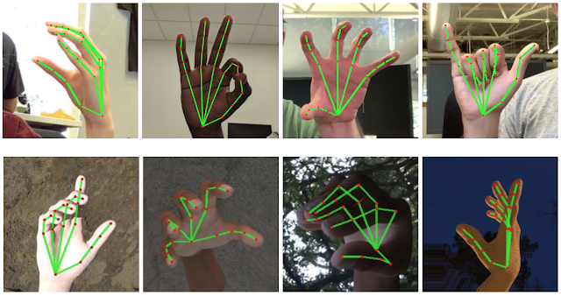
Palm detection over different positions

Slide 13
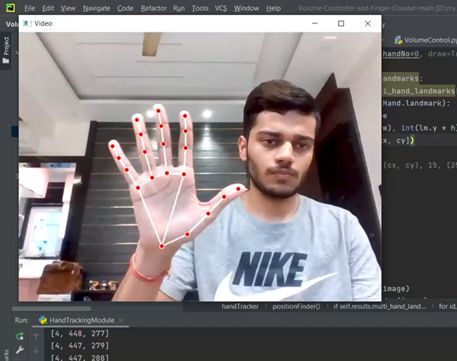
WORKING OF HAND TRACKING MODULE
The Hand detecting module performs precise key point localization of 21 3D palm coordinates in the detected hand region.

Slide 14
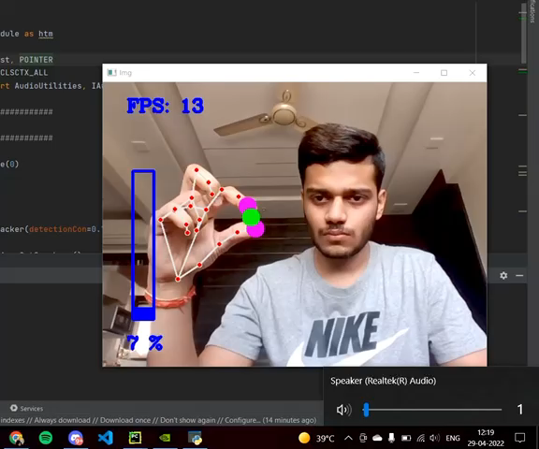
VOLUME CONTROLLER USING
HAND MOVEMENT
Here we can see the volume is changing corresponding to the distance between index finger and thumb finger
Here we can see computer volume being changed

Slide 15
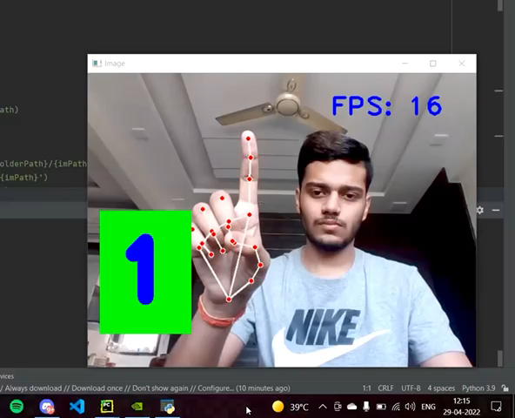
COUNTER USING HAND LANDMARK
OF FINGER
Using the relative positions of 21 points this counter counts number of finger we are showing to camera
Here we can see the number of fingers shown

Slide 16
CONCLUSION AND FUTURE INSIGHTS:
We can conclude that our exploration on this project can be good be use in various fields in daily life. This will reduce the human dependency on hardware.
In this time of pandemic we are avoiding touch to any surface. By our project we can make smart control systems which minimizes human touch.
This have tremendous future use like - smart homes, high security systems etc.
Hand gesture control can also form the basis for sign language understanding

Slide 17
PROJECT BY:
AVINASH SINGH (20095020)
KORIVI VEDHARSHINI (20095055)
NIPUN KHANDUJA (20095073)
THANK YOU

